Slide 1


Airbnb and Zillow
Data Challenge
Shringa Bais

Slide 2
Premise
A few things about New York and its real estate market
Being a real estate investor, how can we benefit from all the numbers I just mentioned?
The goal of this analysis is to recommend zip codes and neighborhoods in New York city for real estate investment
Notes:
The goal of real estate investment is to put money to work today and allow it to increase so that you have more money in the future. In this data analysis we will assist real estate company to understand which zipcodes are more profitable for short term rentals.
As one of the most famous cities in America and the world, New York City property presents unique investment opportunities. There is one problem, however. Real estate in New York is expensive. In fact, a report from Savills Research shows New York City as the most expensive city in the world to rent, and one of the most expensive residential real estate markets.

Slide 3
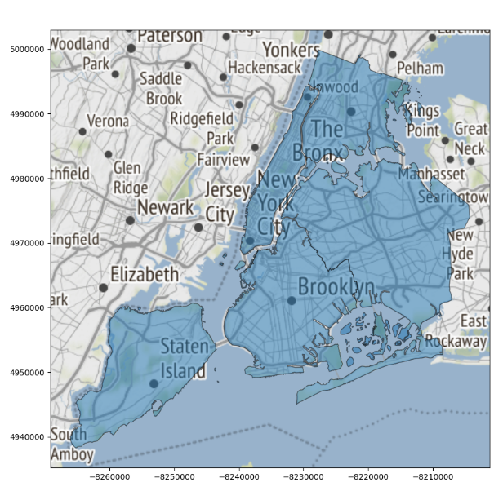
New York Neighborhood

Slide 4
Assumptions | Qualifiers
The investor will pay for the property in cash. Assuming the Occupancy rate is 75%. 365 days on rent. Number of Reviews = Popularity. Lesser the availability, higher the occupancy. | Targeting New York City. 2 bedrooms apartment .
Notes:
No interest rate need to considered while calculating revenue rates.
Company will put properties on rent throughout the year every day.
The number of reviews is identified as popularity among consumers.
Availability for the next 365 days is a status quo as far as occupancy is concerned.

Slide 5
Methodology and Key Metrics
Focussed Analysis on Property Occupancy and Price:
Number of properties per zip code.
Price distribution per zip code.
Occupancy rate per zip code (last 30 days availability).
House pricing and night pricing.
Analysis on Return on Investment:
House cost recovery years.
Popular neighborhoods.
Prime Location
Occupancy Rate
Revenue
Cost Recovery Time
Distance
Primary Data Sources:
Airbnb: http://insideairbnb.com/get-the-data.html
Zillow: https://www.zillow.com/research/data/

Slide 6
Data Cleaning
Zillow dataset (8946, 262)
Airbnb dataset
(40753,95)
Selecting required features, data imputation
Selecting required features.
Filtered dataset (25,94)
Filtered dataset (4894,15)
Merge datasets on zip codes
Final dataset with 22 unique zip codes (1258,109)
Notes:
Zillow dataset shape: 8946,262
Filter data on City = New York (25,94)
No missing data
In order to reduce number of columns to human-interpretable level, considering only those columns which will bring value to our analysis. Median cost price of area is given from 1996 -2017 with more than 20% of NULL values present in columns from 1996 -2009.
Airbnb Dataset: "neighbourhood_cleansed", "Neighbourhood_group_cleansed", "Room_type", "Bedrooms", "city", "latitude", "longitude", "zipcode", "availability_30", "availability_60", "availability_90", "availability_365", "price", "weekly_price", "monthly_price"
Airbnb dataset shape: 40753,95
611 missing zip codes: Filled using latitude and longitude data.
69 missing no. of bedrooms data: Filled using the median value
Incorrect zip code format: Considered first 5 digit value
Incorrect data type: Converting cost columns (price, weekly and monthly price) to float type and removed special characters like $,
Repetitive City names
Removed low variance features.
Filter data on no. of bedrooms = 2.0 (4894,15)
75.57% of weekly prices missing and 85.61% Monthly prices missing : Filled using nightly price column.

Slide 7
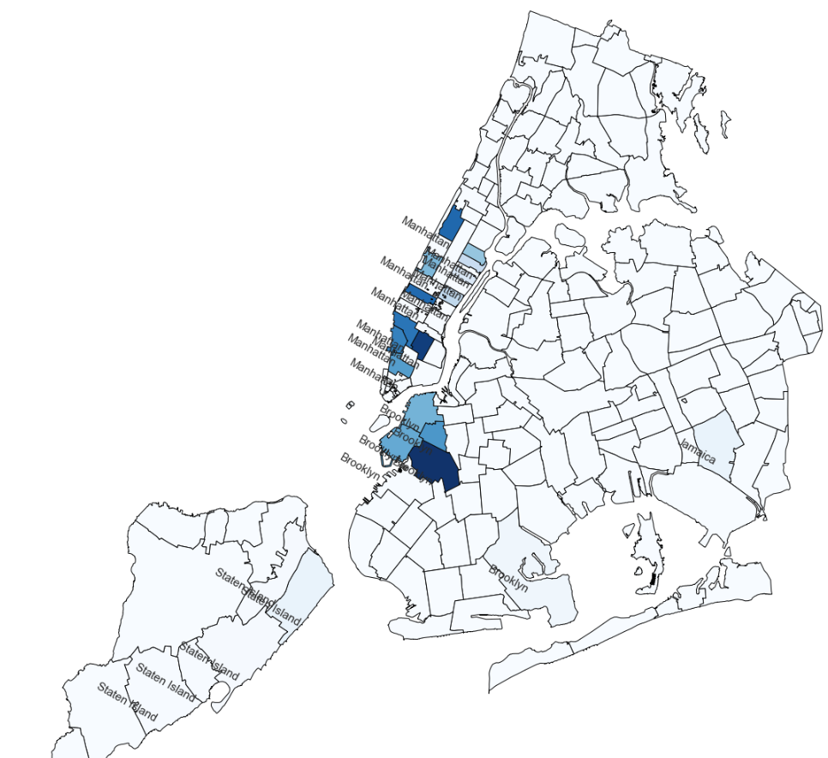
No. of listings around New York
Notes:
Highest number of properties are listed in Manhattan followed by Brooklyn, Staten Island and then Queens.

Slide 8
Zip codes as per Neighborhood
Manhattan | 10003, 10011, 10013, 10014, 10021, 10022, 10023, 10025, 10028, 10036, 10128
Brooklyn | 11201, 11215, 11217, 11231, 11234
Staten Island | 10304, 10305, 10306, 10308, 10312
Queens | 11434

Slide 9
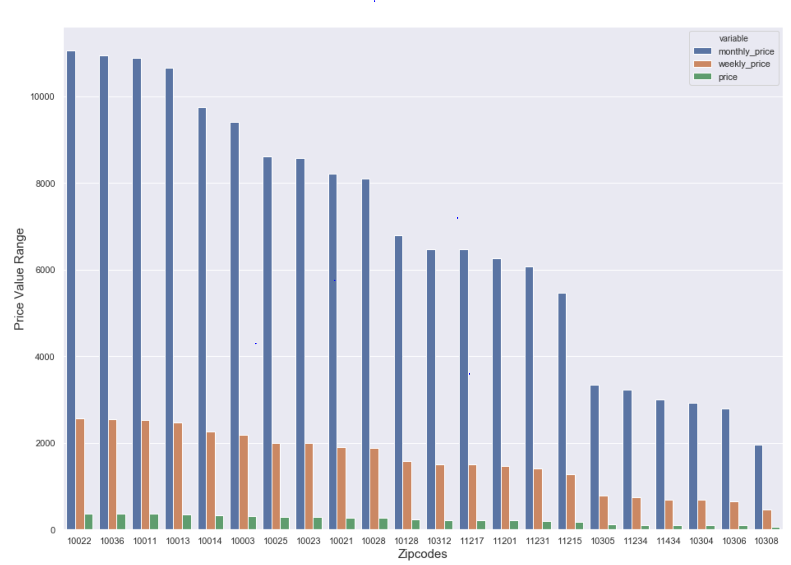
Price Distribution per zip code
Top 10 zip codes come under Manhattan area which shows that highest paying rental neighbourhood in Manhattan followed by Brooklyn.
As from the count of listings we obtained in the previous plot, it is also the most popular neighborhood.

Slide 10
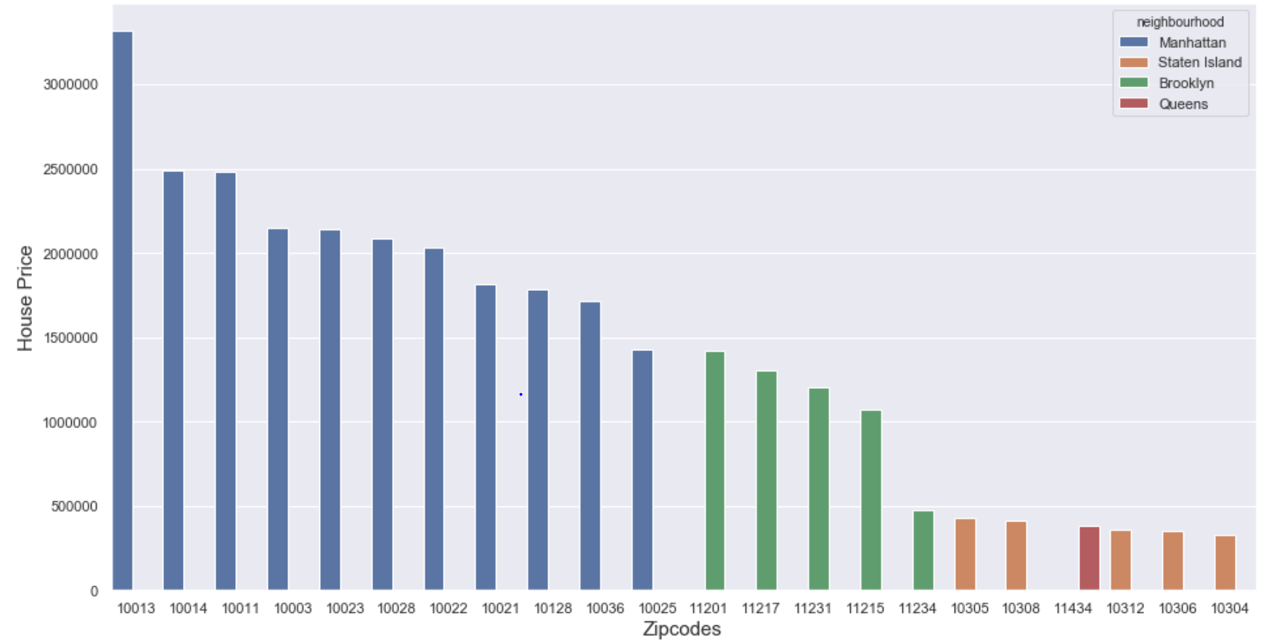
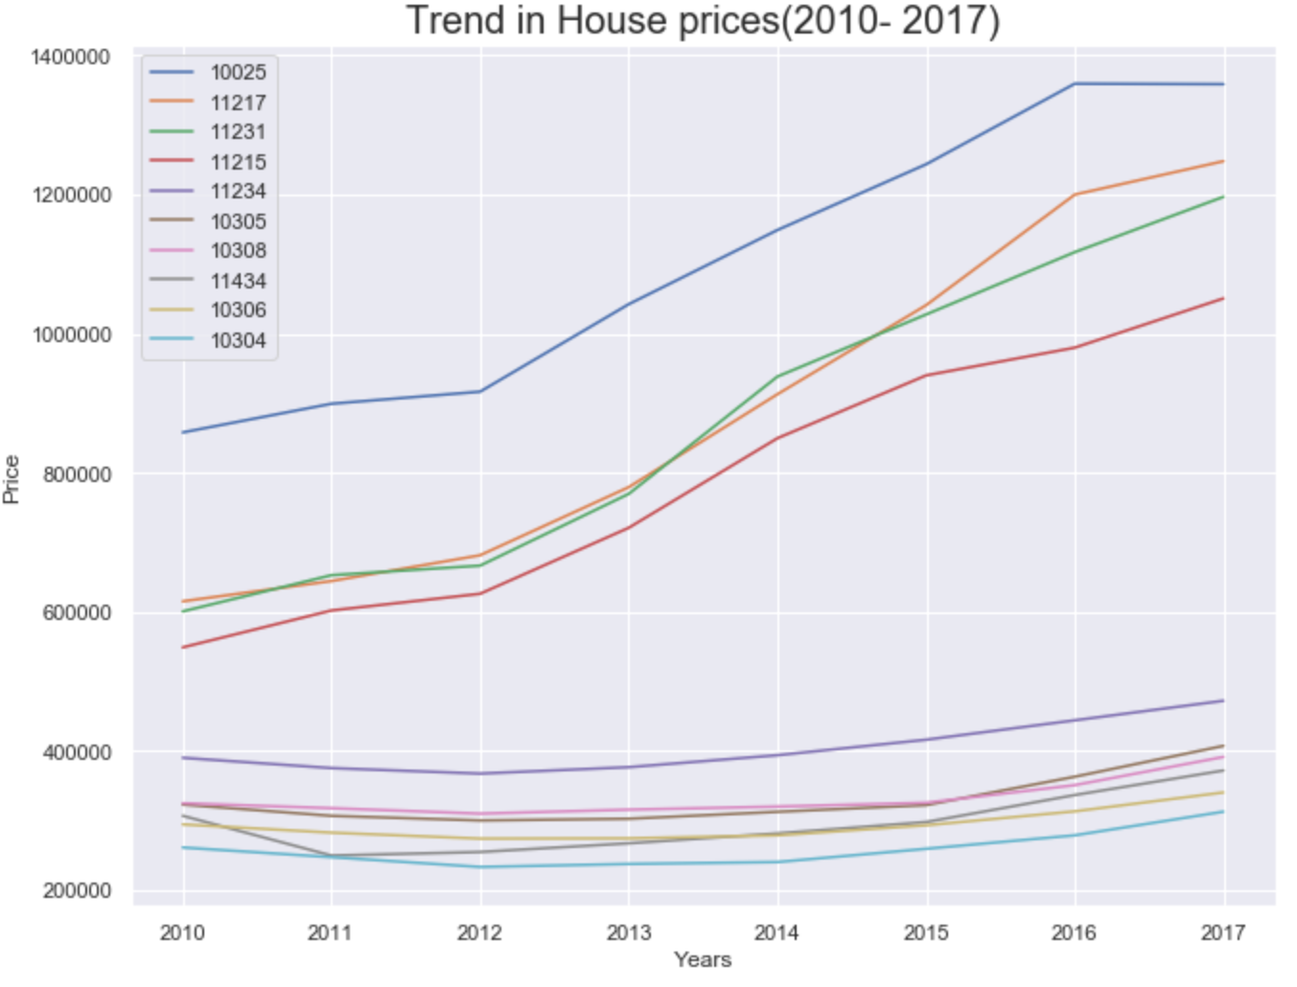
Latest house price per zip code

Slide 11
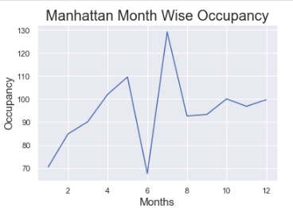
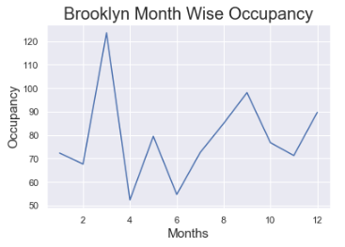
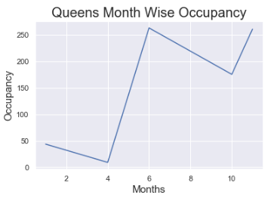
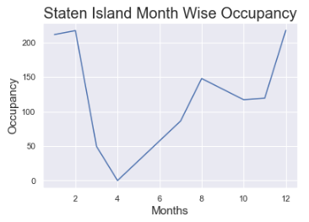
Season wise Occupancy

Slide 12
Engineered Features for dataset
Avg nightly rates - Average per night prices per zip code. By calculating the mean of column Price/zip code.
House prices (2017)- Latest house prices from Zillow dataset which is from the year 2017 and month 06
Number of listings- counts of listing per zip code
Weighted rates/ nightly- per night weighted average rate
Nights to recover- Number of rented nights to recover the cost of the house (house price/ average nightly rates)
% booked (last 30 days)- Percentage of rented apartments booked in the given zip code as per availability_30 column.
Distance from central New York- Distance of zip codes from central New York city.
Slope - slope of housing prices, helps in predicting future house prices.

Slide 13
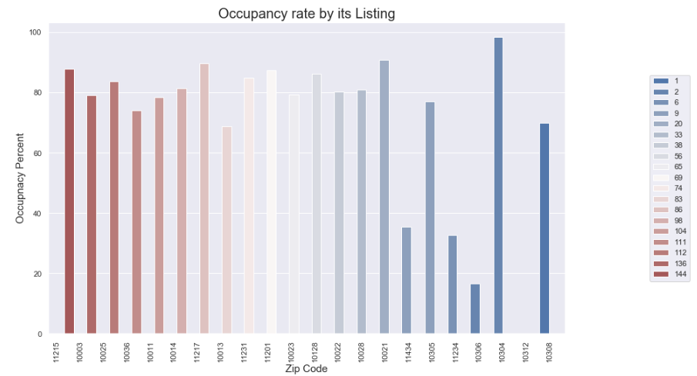

Slide 14
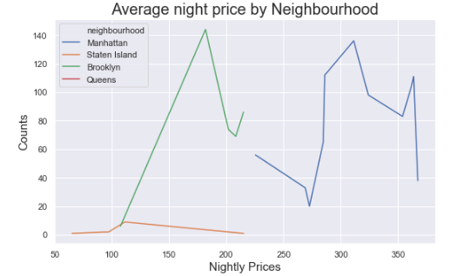

Slide 15
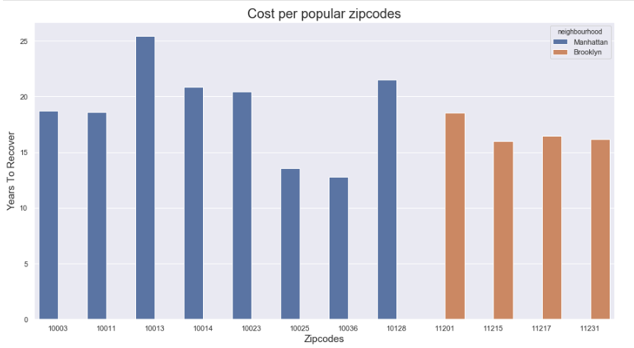

Slide 16
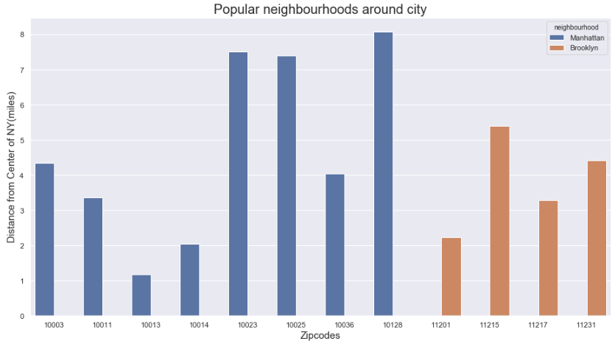

Slide 17
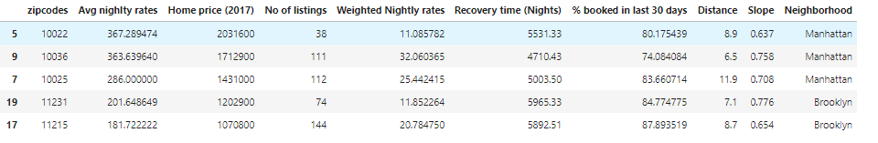
Conclusion
I am concluding my analysis on the basis of below metrics:
Prime Location (counts) - Most popular zip codes in the area/ choice of homes.
House Cost (home_prc_2017) - Lowest cost house prices.
Occupancy Rate (pct_booked_30) - Popular rental areas by Airbnb users.
Revenue (avg_nightly_rates) - Highest nightly prices.
Cost Recovery (nights_to_recover) - Lowest time Period to recover house cost.
Distance (dist_center) - zip codes near to the New York City.
Notes:
Weighted_rates_nightly - Average price in a zipcode
By applying reasonable cut off values (again it depends on investor) on above metrics we got these zipcodes:
1) 10022 satisfies all metrics and looks good for investment as its cost recovery time is less with great nightly revenue rates. By looking at that there is not much rental listing avaible over here which reduces the competition and it closer to the center of city. One more important point to look after is ath the slope column which is less as compared to others means that chance of increasing housing price is low in near future.
2) 10036 also looks good its just it has higher number of rental options available in that area and chance of increasing house cost is also little high.
3) Other 3 zipcodes 10025, 11231 and 11215 falls under same metrics and covers major areas like Manhattan and Brooklyn

Slide 18
Actions
Important metrics for deciding factor:
Seasonality
Average Nightly Rates
Recovery Time
Notes:
Due to the extreme popularity in real estate investments, there are some things to keep in mind if you plan to invest. The first key is to realize you’re competing with many other investors. However, that isn't the only thing to look out for:
Lower income areas tend to have more maintenance issues as well as higher turnover.
Compare sales price against what you can earn in rent so you don’t over-leverage yourself.
Ultimately, there is opportunity to be had investing in New York City real estate if you’re able to act fast and have a good plan in place.
NO variance in reviews data , not providing any specific data

